Slide 1
Python RESTful API

Slide 2
Content
What is REST API?
Types of API request.
Why using python to write API?
Installing Python, virtualenv, Flask
Writing API codes
Running Python code
Testing API codes

Slide 3
By the end of this session:-
Understand what is API
Write & test API

Slide 4



1. What is API?
REST API is Representational State Transfer Application Programming Interface.
API is a web service that link between two application.
API takes Request from client to server then return Response
In simple terms, its like Restaurant Analogy.
https://www.youtube.com/watch?v=s7wmiS2mSXY

Slide 5
2. Types of API request
API Request uses HTTP Method
GET - http://www.appdomain.com/users
- http://www.appdomain.com/users/123
- http://www.appdomain.com/users/123?name=‘xxx’&age=‘yy’
POST - http://www.appdomain.com/users
- http://www.appdomain.com/users/123
- http://www.appdomain.com/users/123?name=‘xxx’&age=‘yy’
PUT - http://www.appdomain.com/users/123
- http://www.appdomain.com/users/123?name=‘xxx’&age=‘yy’
DELETE - http://www.appdomain.com/users/123
- http://www.appdomain.com/users/123?name=‘xxx’&age=‘yy’
Ref : https://restfulapi.net/http-methods/

Slide 6
3. Why using Python to write API?
Ease of learning python syntax
Have lots choices of web framework, e.g. Django, Flask, and so on
Python Flask microframework can up and running less then 5 min
Python is More Versatile than PHP. Can be used to develop Machine Learning, Natural Language Processing, data science, image processing, and desktop and mobile application development

Slide 7
4. Installing Python, virtualenv, Flask
Install latest python.
- check if python is already installed by query in CMD
>>> python –V
Install virtualenv.
>>>pip install virtualenv
- if virtualenv already installed, it will prompt “Requirement already
satisfied”

Slide 8
4. Installing Python, virtualenv, Flask
Create new folder in desktop.
Run CMD
Go to new folder in desktop
>>> C:\Users\User>cd Desktop\<new_folder>
Create virtualenv inside new folder
>>> C:\Users\User\Desktop\<new_folder>>virtualenv <VENV-NAME>
Activate virtual environment
>>> ..\<new_folder>\<VENV-NAME>\Scripts>activate.bat
- to deactivate just use >>> 'deactivate’
Install required pacakges (in the activated virtualenv)

Slide 9
4. Installing Python, virtualenv, Flask
Installing Flask in the activated virtualenv
>>>pip install Flask

Slide 10
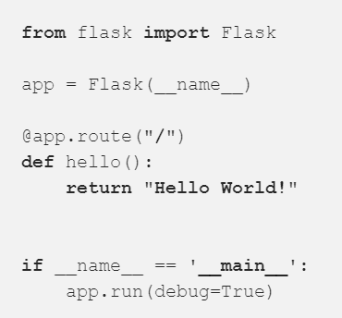
5. Writing API codes
Create new text file inside the <new_folder>
Rename to app.py
Write this code

Slide 11
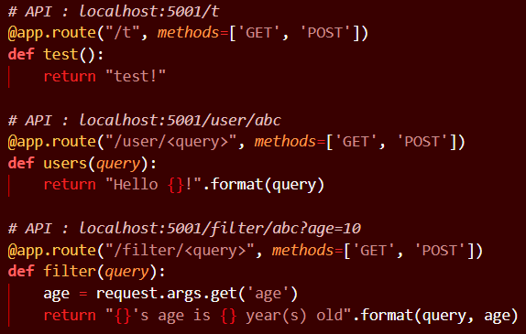
5. Writing API codes
E.g. of API

Slide 12
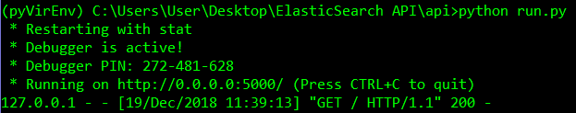
6. Running Python code
Run CMD
>>> C:\Users\User\Desktop\<new_folder>>python app.py

Slide 13

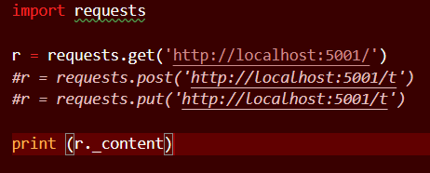
7. Testing API codes
Direct query in chrome url
Use python to do request
Create new text file inside the <new_folder>
Rename to HTTPClient.py
Write the code below

Slide 15
End of Session
Question???

